Slide 1

Multi-class SVM
Professor Bo Liu
James Watt School of Engineering

Slide 2
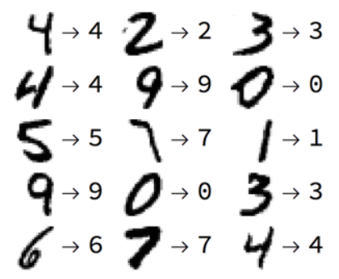

Multi-class SVM
SVM is binary classifier, it does not support multiclass classification natively.
However, many classification problems are multiclass:
Handwritten digits recognition
Music recommendation: rock, pop, metal, or hip-hop
classical
rock
pop
metal
hiphop

Slide 3
Multi-class SVM
The idea: breaking the multiclassification problem into multiple binary classification problems.
Two approaches of breaking:
One-vs-Rest: separate one class and the rest class
One-vs-One: separate every two classes
green/rest
blue/rest
red/green
blue/red
red/rest
blue/green
one-vs-rest
one-vs-one

Slide 4


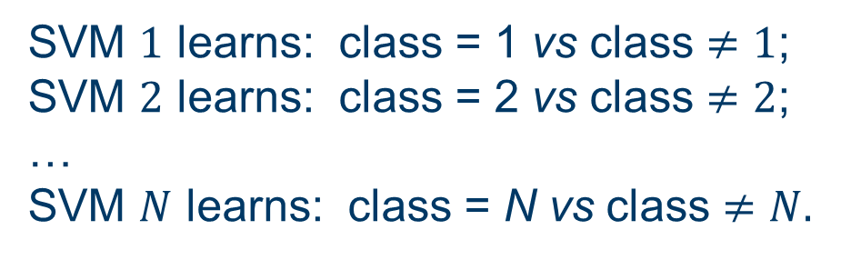
One-vs-Rest
Suppose we have an $N$ class problem.
  One-vs-Rest: separate one class and the rest class
Learning: $N$ SVMs are learned.
blue/rest
green/rest
SVM $1$ learns: class = 1 vs class $≠1$;
SVM $2$ learns: class = 2 vs class $≠2$;
…
SVM $N$ learns: class = N vs class $≠N.$
red/rest
one-vs-rest

Slide 5
One-vs-Rest
Prediction: predict with each of the build SVMs and then find which one puts the prediction the farthest into the positive region.
blue/rest
green/rest
positive region of blue/rest SVM
negative region of blue/rest SVM
red/rest
one-vs-rest
In a One-vs-Rest SVM:
Positive region: the region where the positive class (the “One”) are located.
Negative region: the region that contains the other classes (the “Rest”).

Slide 6
One-vs-Rest
Prediction: predict with each of the build SVMs and then find which one puts the prediction the farthest into the positive region.
green/rest
blue/rest
negative region of red/rest SVM, distance ignored
red/rest
one-vs-rest
The point is predicted as blue.

Slide 7


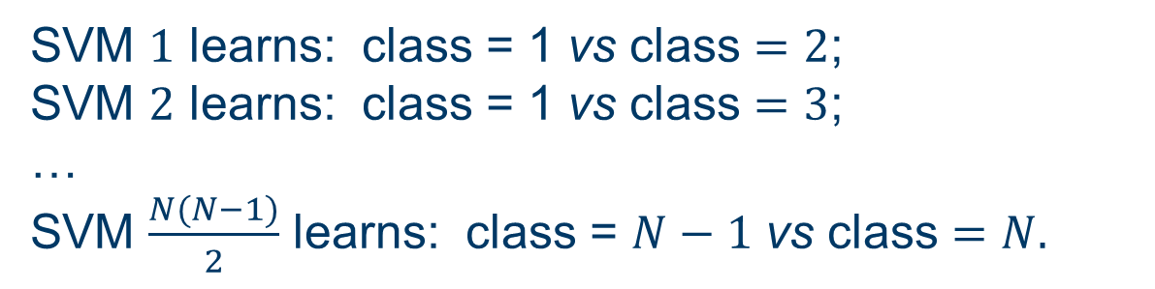

One-vs-One
Suppose we have an $N$ class problem.
  One-vs-One: separate every pair of classes.
  There will be $\frac{N(N−1)}{2}$ combinations.
red/green
blue/red
Learning: $\frac{N(N−1)}{2}$ SVMs are learned.
SVM $1$ learns: class = 1 vs class $=2$;
SVM $2$ learns: class = 1 vs class $=3$;
…
SVM $\frac{N(N−1)}{2}$ learns: class = $N−1$ vs class $=N.$
blue/green
one-vs-one

Slide 8

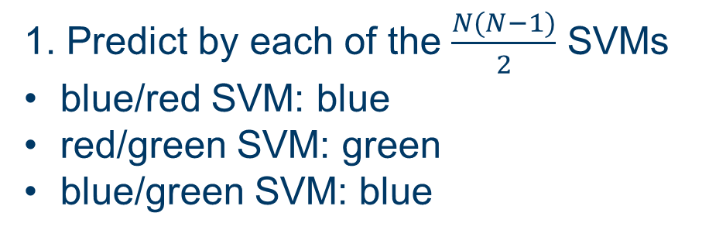
One-vs-One
Suppose we have an $N$ class problem.
Prediction
red/green
blue/red
1. Predict by each of the $\frac{N(N−1)}{2}$ SVMs
blue/red SVM: blue
red/green SVM: green
blue/green SVM: blue
2. Majority vote:
  The majority prediction made by these SVMs are “blue”.
  Then we predict that the point is blue.
blue/green
one-vs-one

Slide 9




Thanks!
#UofGWorldChangers
@UofGlasgow

